Slide 1



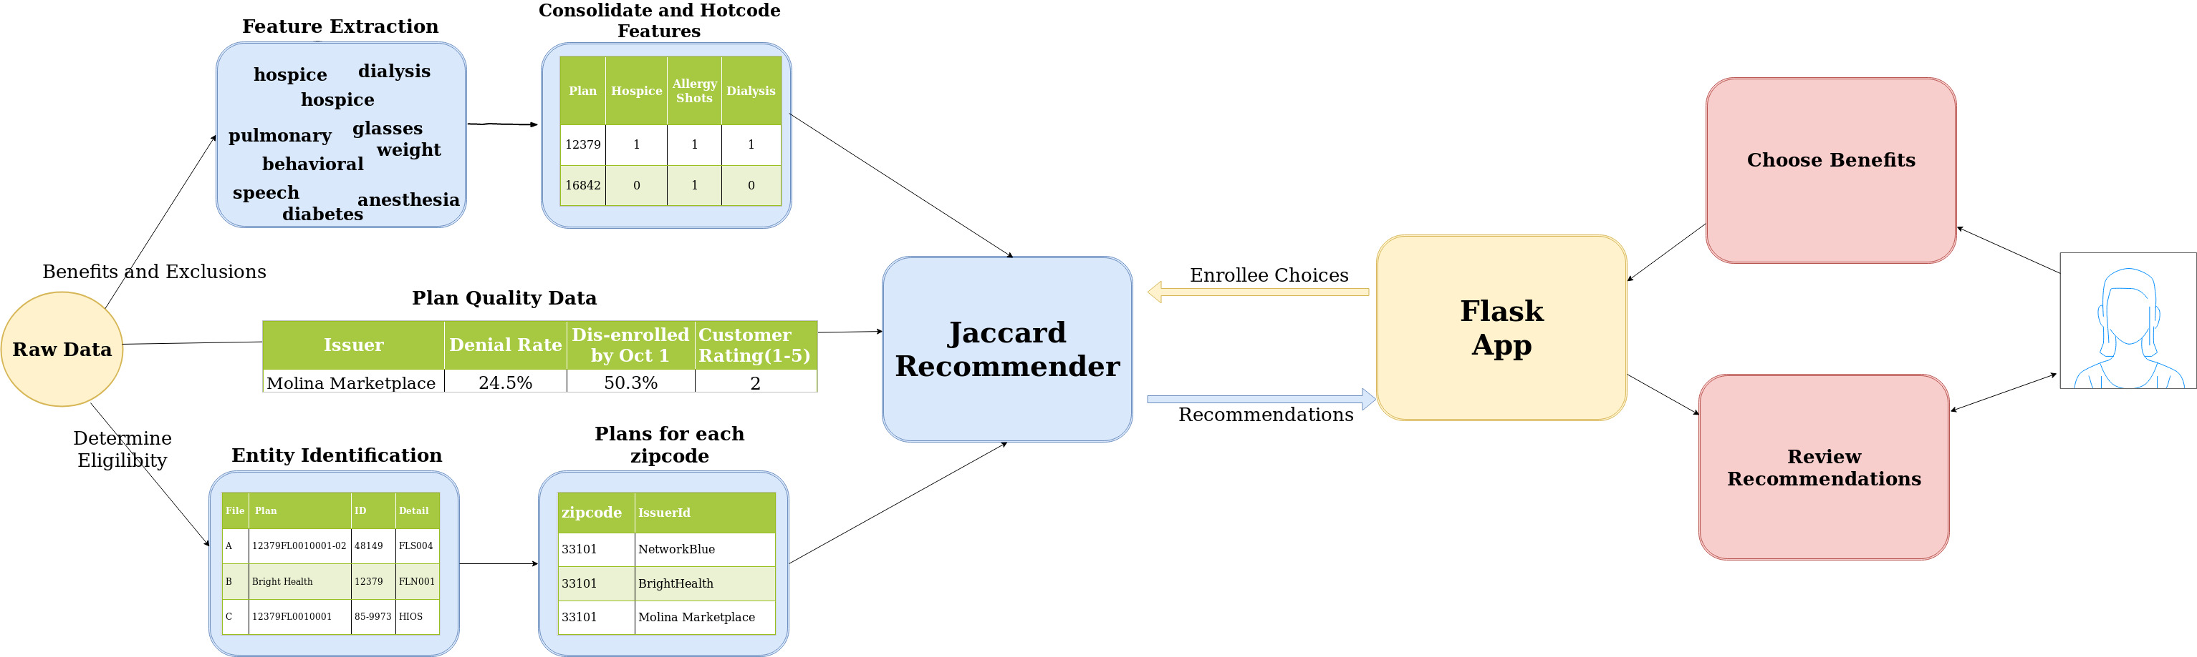
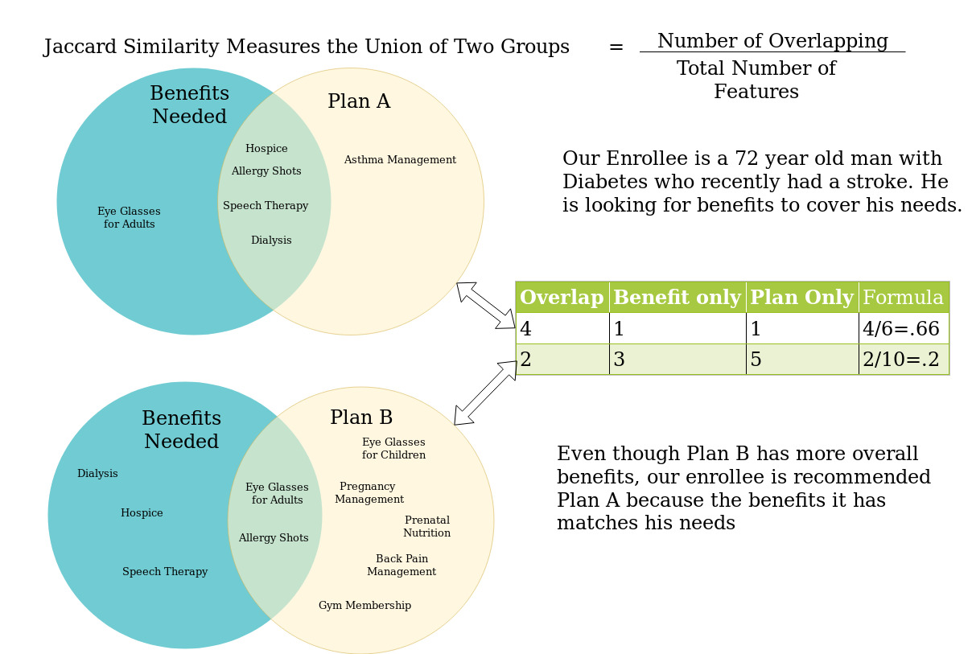
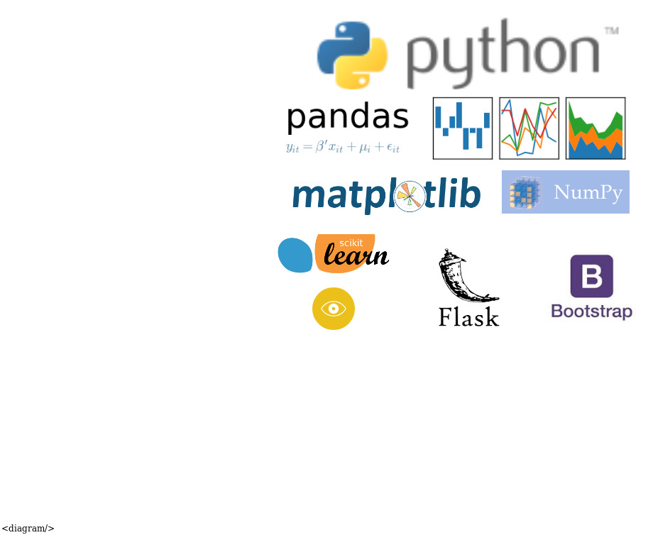
2020 Florida Healthplan Recommender
Mike De Lancey
/github.com/delancey314
in
/in/mikedelancey
mike.delanceyds@gmail.com
How it works
A
What is Jaccard Similarity?
Background
At over 1.7 million enrollees in the 2019 Healthcare Marketplace, Florida had more than the bottom 25 states combined. This application seeks to simplify the process to choose the right plan.
(
Tech Stack
What’s Next?
Expand to other states on the marketplace
Incorporate plan pricing
Include dental only plans
(
References
1. Centers for Medicare and Medicaid Services -Health Insurance Exchange Public Use Files. https://www.cms.gov/CCIIO/Resources/Data-Resources/marketplace-puf.html
2. USDA – County FIPS codes.
https://www.nrcs.usda.gov/wps/portal/nrcs/detail/national/home/?cid=nrcs143_013697
3. Bootstrap themes
https://startbootstrap.com/themes/

